Slide 1

Screening Autism Spectrum Disorder in Children on Facial Images

Slide 2
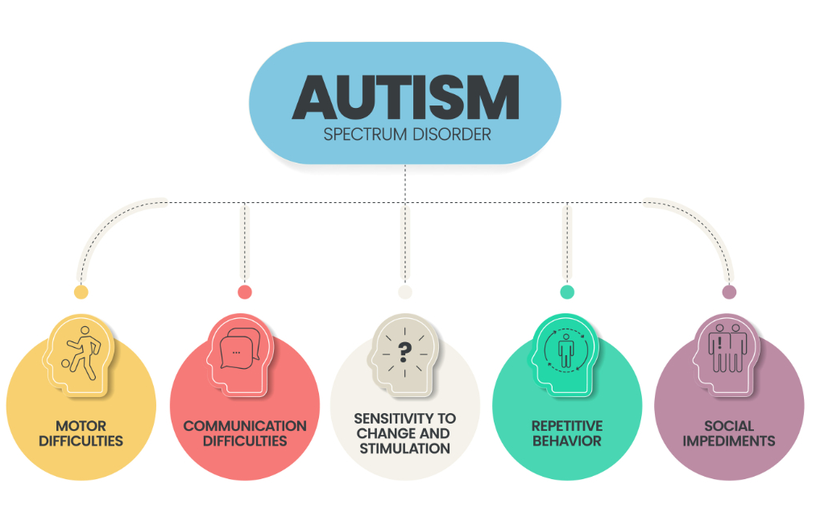
Abstract
Autism Spectrum Disorder(ASD) is a neurodevelopmental disease which has an effect on how individuals connect with others, communicate, grasp.
Autism is disorder where people face problems with
Lack of social communication
Shows repetitive interest or behaviour
Cannot socialize with people.
Traditional neural networks have shown promising results in screening ASD.
In this study we have used Feature Pyramid Network(FPN) to improve the performance of various deep learning models like CNN, VGG16.
Amongst all, the VGG16+FPN model achieved a highest accuracy of 92%.

Slide 3
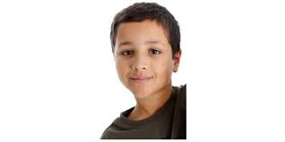
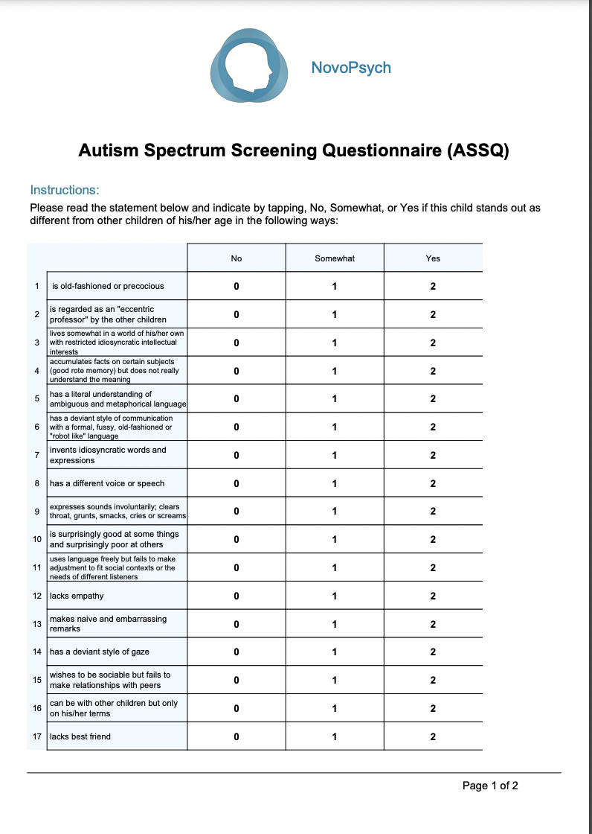
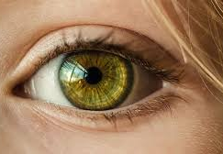
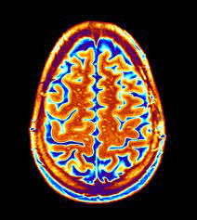
Introduction
Questionnaire
Facial Images
The first Autism Spectrum Disorder case was recorded in 1933.
The Initial step -- talking to parents which help in finding their behaviour.
With the advancement of technologies Artificial Intelligence (AI) and Machine Learning (ML) are playing a vital role in ASD Detection.
There are various machine learning models like VGG, CNN etc. showcasing good result in the medical field.
Here we tried to implement CNN, VGG and FPN on Facial Images.
FPN combines features from different levels of a convolutional neural network to improve accuracy at various object scales
Eyeball movement
fMRI
Various screening methodologies to diagnose ASD

Slide 4
Related Work
Kanner was the first person who identified and published the first methodical illustration of early infantile autism in the year 1943. Kanner, a lifelong supporter of children, emphasised that each child must be treated as a unique individual, regardless of how well developed our criteria are, when discussing the DSM III criteria in 1980.
Marco Leo surveyed the analysis of facial information using various computer vision techniques which deal with analyzing facial components like Eye, mouth, facial muscles, and shape tools like gaze tracking, speech recognition, and emotion recognition. This data was given to clinicians and therapists to monitor the children's behavior to diagnose autism. Pramit Mazumdar developed a CNN model which uses an eye-tracking image dataset and achieved an accuracy of 83% accuracy.
Lin et al, presented a clean and simple framework for building feature pyramids inside ConvNets. This approach exceeds a number of credible baselines and competition winners. As a result, they provided an efficient method for studying and using feature pyramids without the requirement for image pyramid computation. By this work finally states that it is still critical to address multiscale problems using pyramid representations.

Slide 5
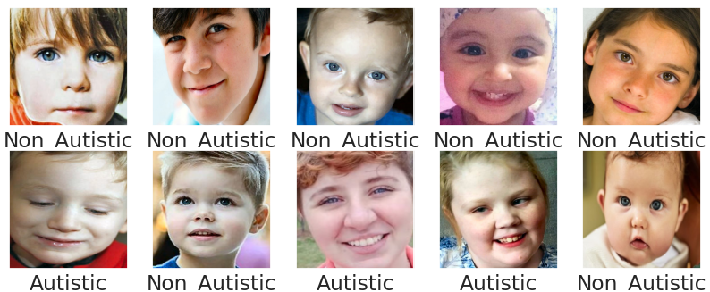
Dataset Description
It is an open source data named Autism Facial Images which is available in Kaggle.
This dataset consisted of facial images of children who are Autistic and Non-Autistic.
In total, the dataset contains 2928 images where
1464 are autistic
1464 are non-autistic
The dataset is divided into training and testing dataset in the ratio of 80:20.

Slide 6
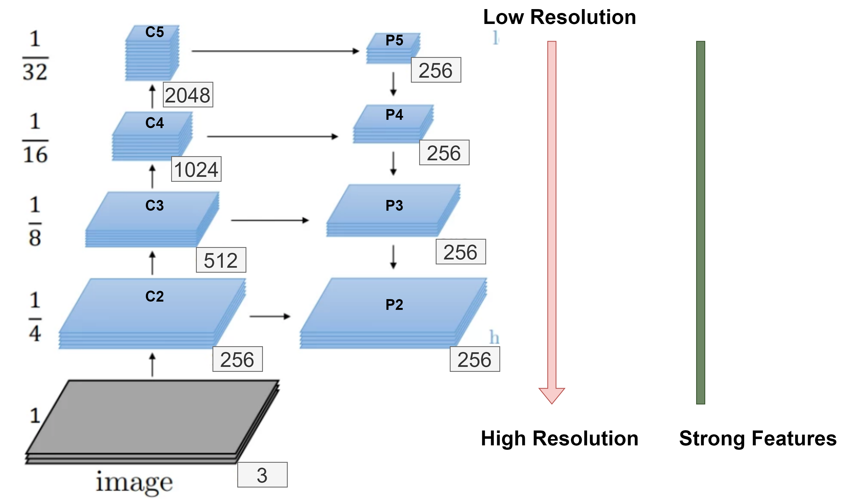
Feature Pyramid Network(FPN)
FPN is a deep learning architecture commonly used in object detection and segmentation.
The main goal of FPN is to address the challenge of detecting objects at multiple scales within an image.
It achieves this by creating a feature pyramid, which consists of a set of feature maps at different resolutions.
It has 2 pathways and a lateral connection namely:
Bottom-up pathway
Top-down pathway
High-resolution features provide fine-grained details for detecting small objects, while low-resolution features capture context and semantics for larger objects.

Slide 7
CNN
VGG16
CNN is one of the deep learning methods used to create models for a variety of applications.
CNN reduces an image to its lower dimensions without loosing its characteristics.
Typically, CNN consists of three layers:
a convolutional layer,
pooling layer and a
fully connected layer.
VGG16 is a 16-layer deep neural network
VGG16 is thus a relatively extensive network with a total of 138 million parameters
It also has 3 layers:
a convolutional layer,
pooling layer and a
fully connected layer.

Slide 8
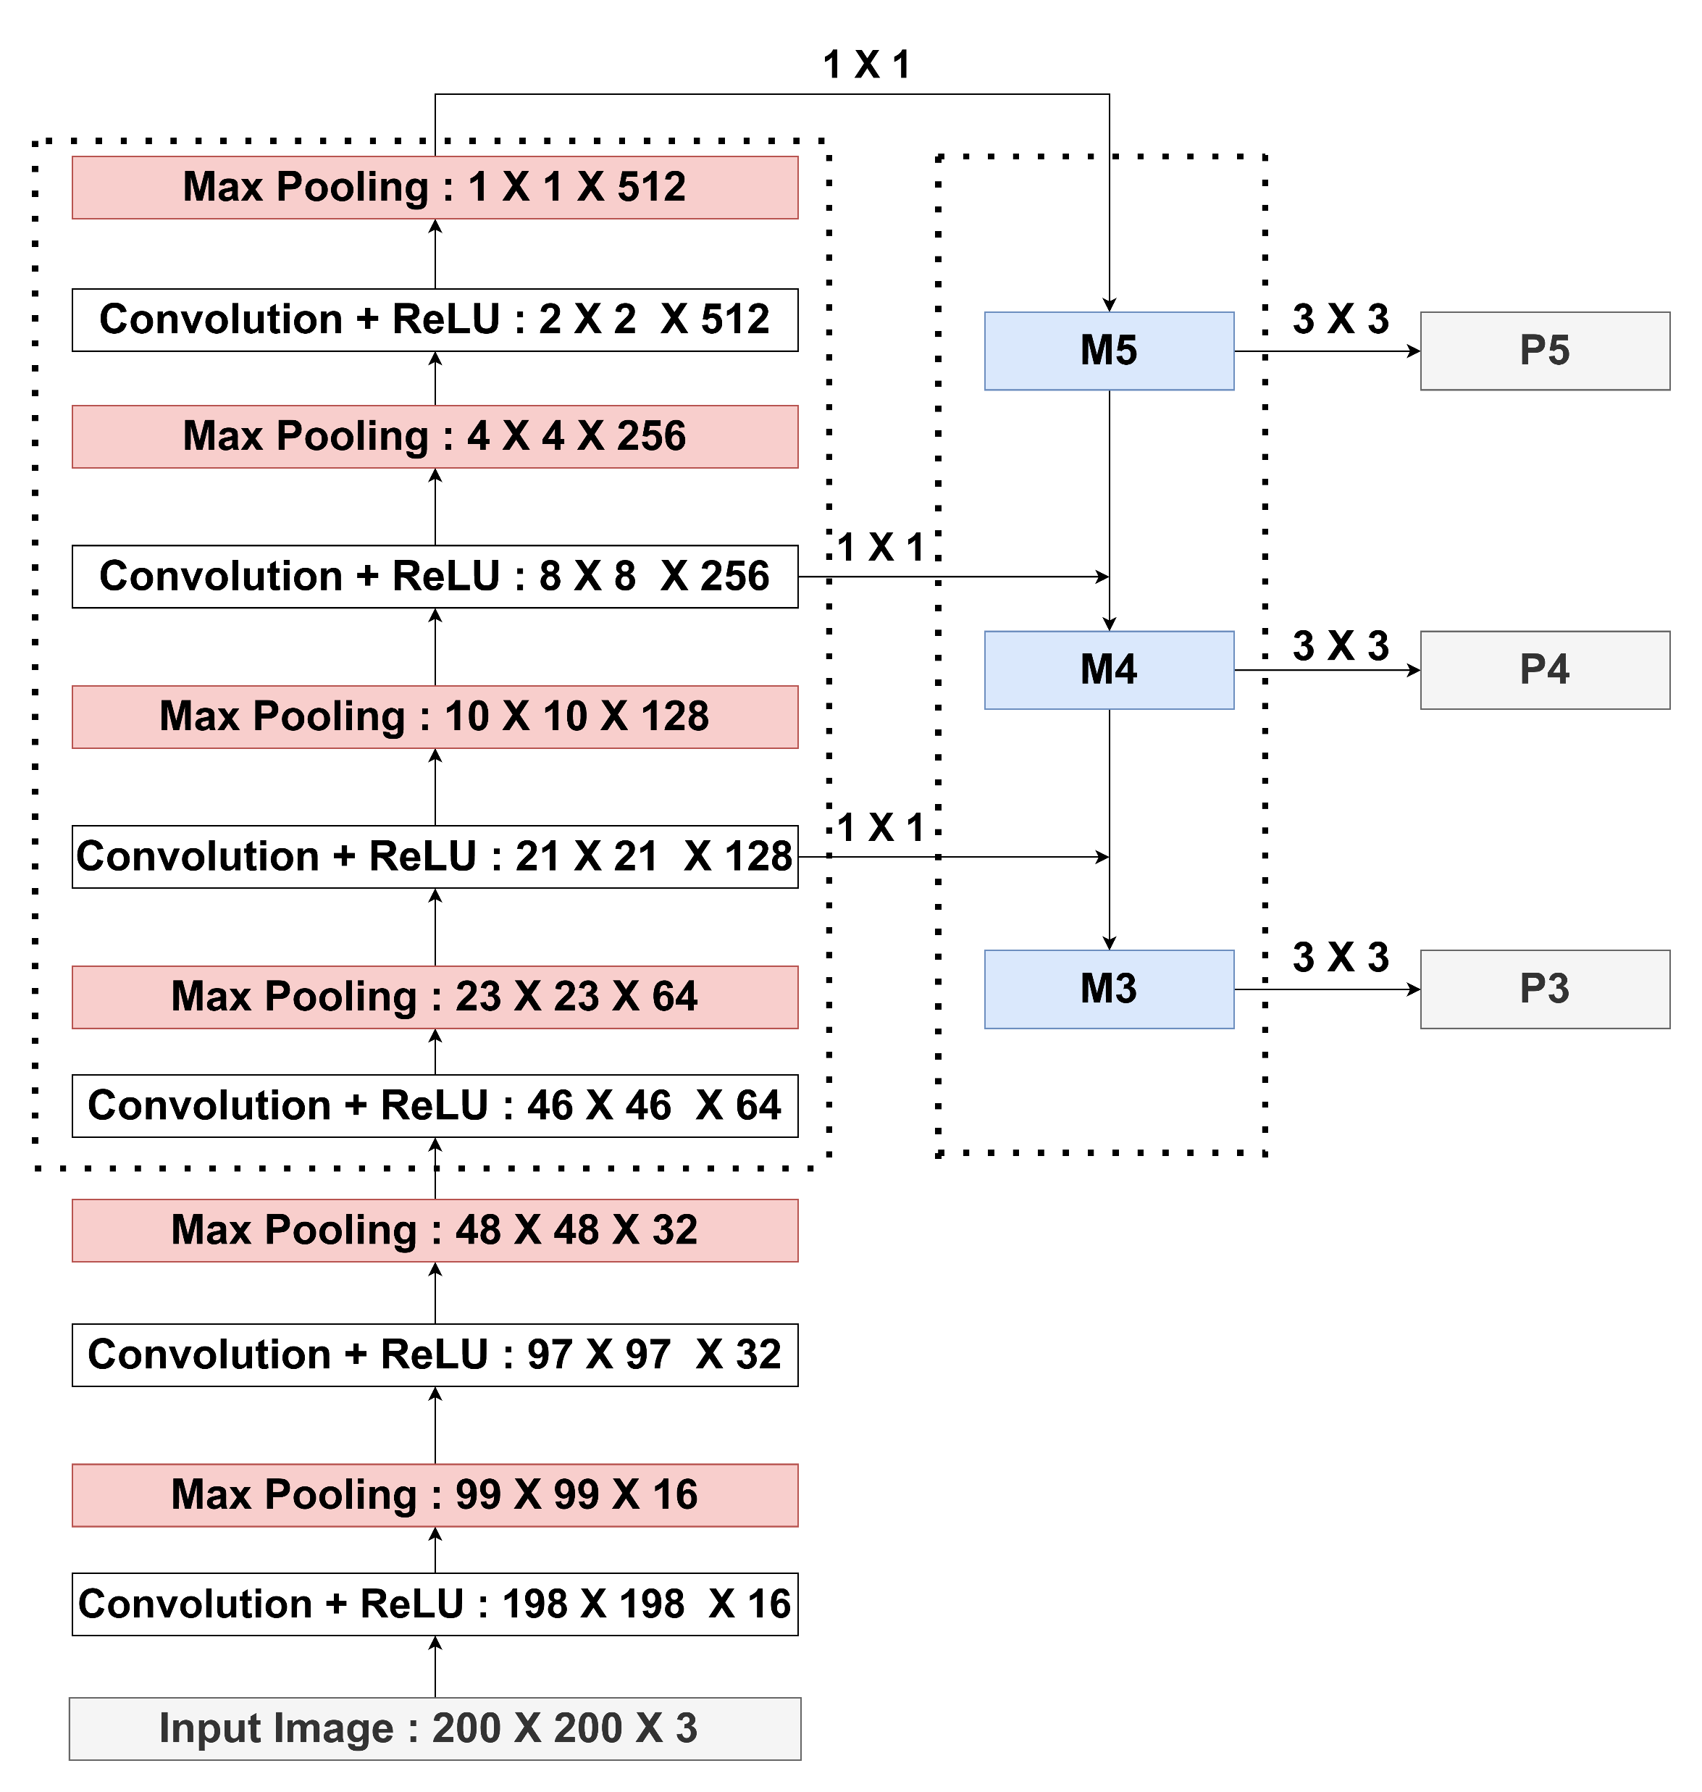
FPN Architecture

Slide 9
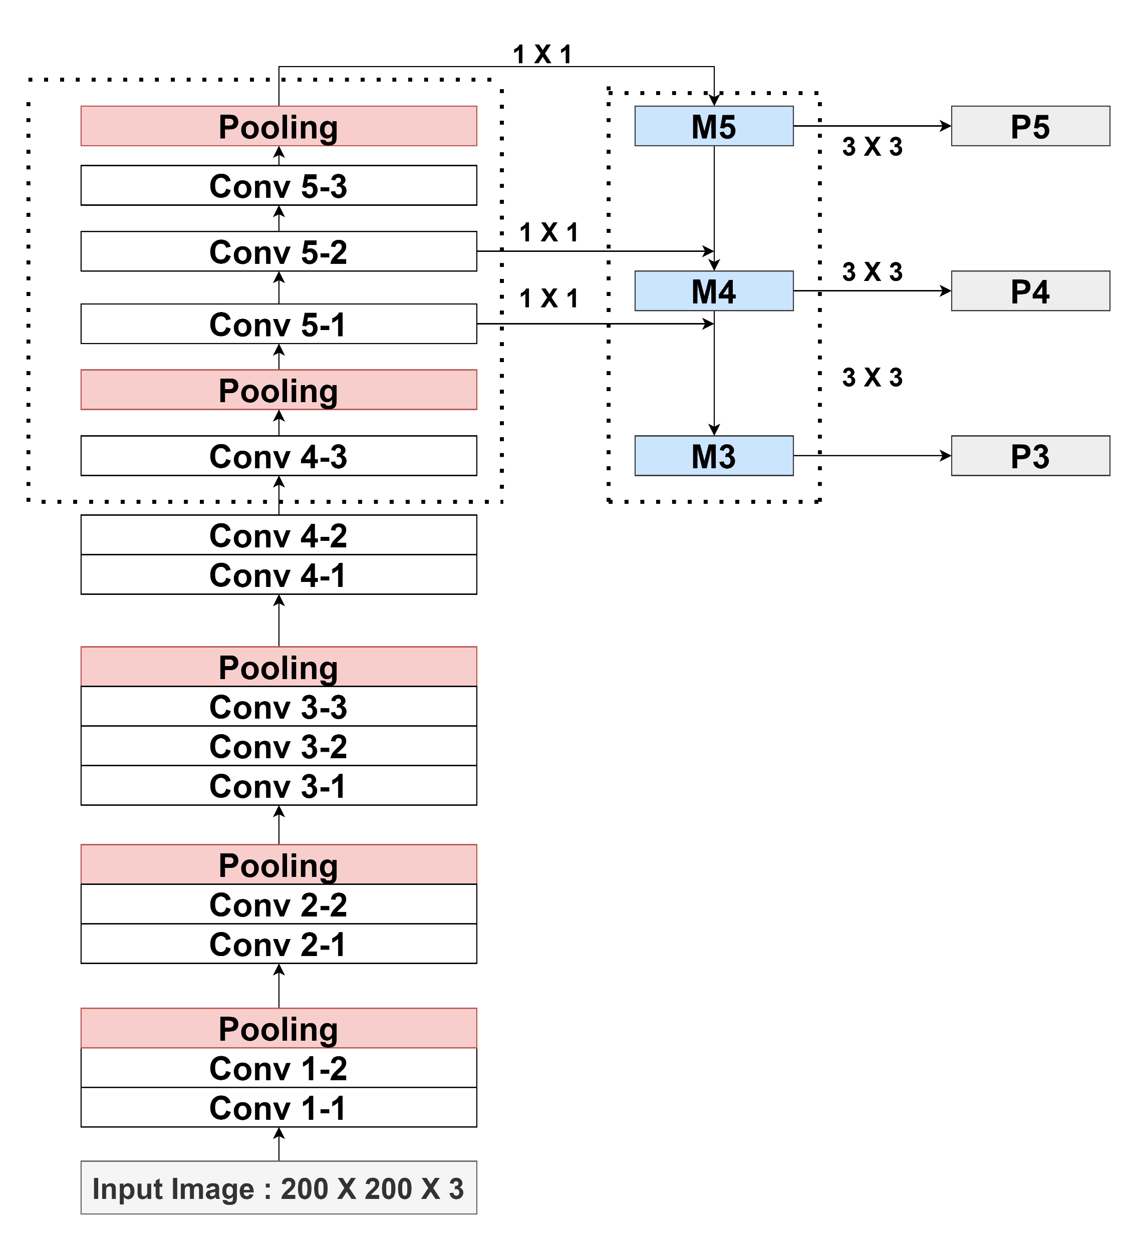
VGG16+FPN

Slide 10

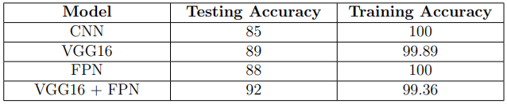
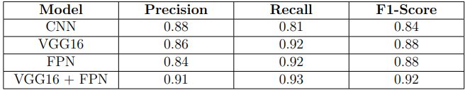
Results
The deep learning models which were proposed in the paper were trained using the Google Colab Environment.
Every model was trained for 100 epochs with 8 as batch size.
The results of CNN, VGG, FPN and VGG with FPN

Slide 11

Conclusion and future scope
In recent years deep learning acquired a major position in healthcare sector.
Our work focused on identifying whether a child is diagnosed with ASD or not. We have considered CNN, VGG16, FPN and VGG16+FPN models for our work.
Amongst the four models, VGG16+FPN, a transfer learning based approached achieved highest accuracy of 92%.
FPN+CNN and VGG16 has improved the performance which demonstrates the importance of feature extraction in deep-learning models.
As there is an advancement in technology, the future scope can considering ECG, Speech recognition, 23 behavioral, and iris data along with the facial image dataset to acquire better results with improved accuracy for the early prediction of the autism spectrum disorder within infants to reduce the effect.

Slide 12
References
Harris, J. (2018). Leo Kanner and autism: a 75-year perspective. International review of psychiatry, 30(1), 3-17.
Mazumdar, P., Arru, G., & Battisti, F. (2021). Early detection of children with autism spectrum disorder based on visual exploration of images. Signal Processing: Image Communication, 94, 116184.
Lin, T. Y., Dollár, P., Girshick, R., He, K., Hariharan, B., & Belongie, S. (2017). Feature pyramid networks for object detection. In Proceedings of the IEEE conference on computer vision and pattern recognition (pp. 2117-2125).

Slide 13



